Slide 1
Unsupervised Learning of Video Representations using LSTMs (LSTM AE)
Nitish Srivastava University of Toronto 2015 ICML

Slide 2
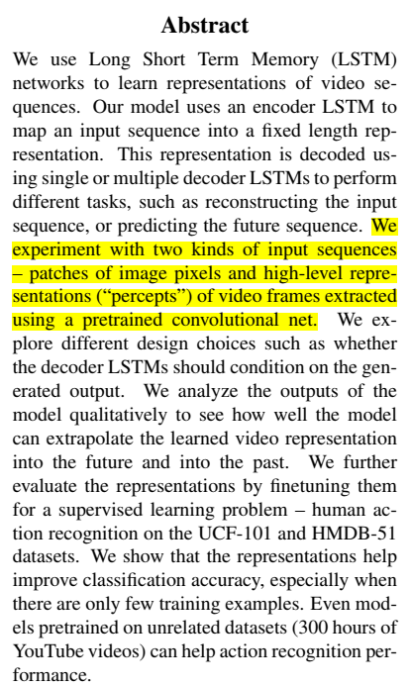
1
Scenario & Problem

Slide 3
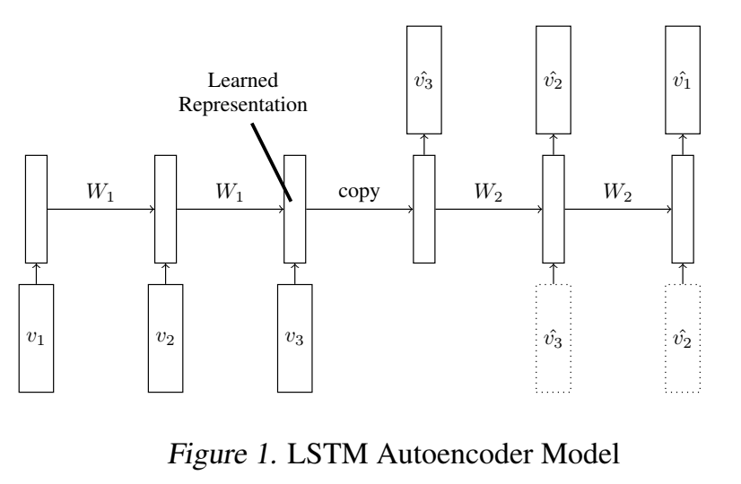
1
LSTM Autoencoder Model

Slide 4
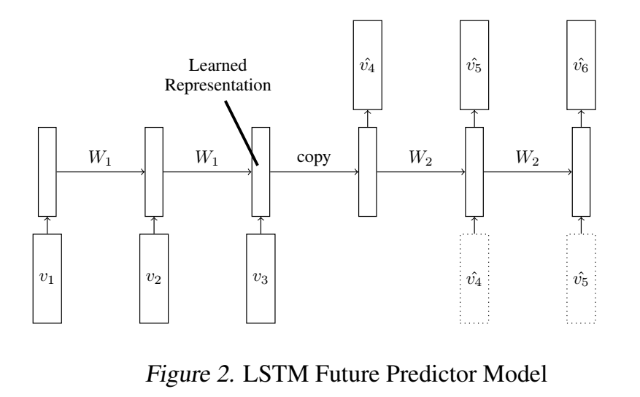
1
LSTM Future Predictor Model

Slide 5
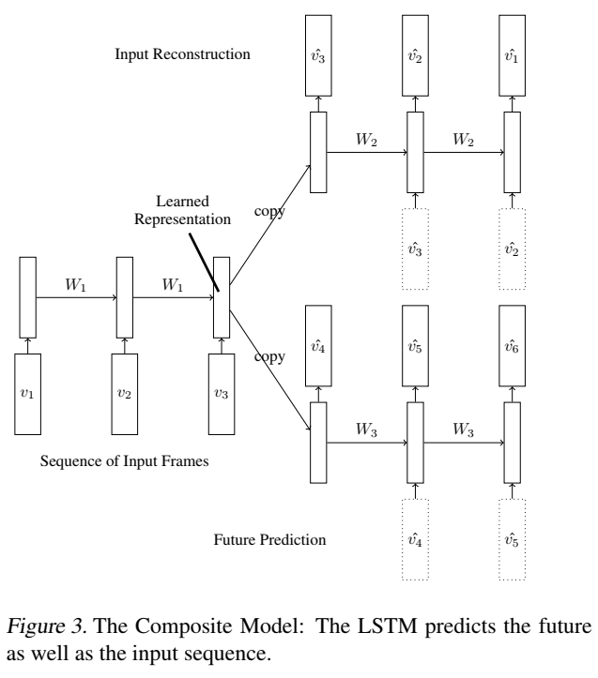
1
Composite Model

Slide 6
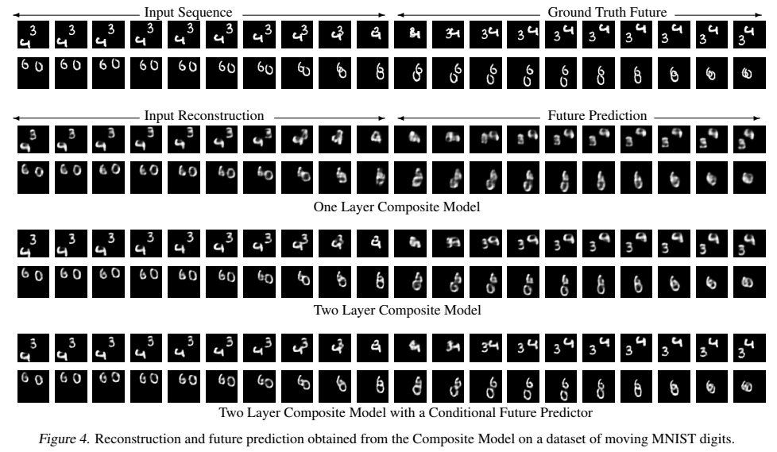
1
Composite models on MINIST

Slide 7
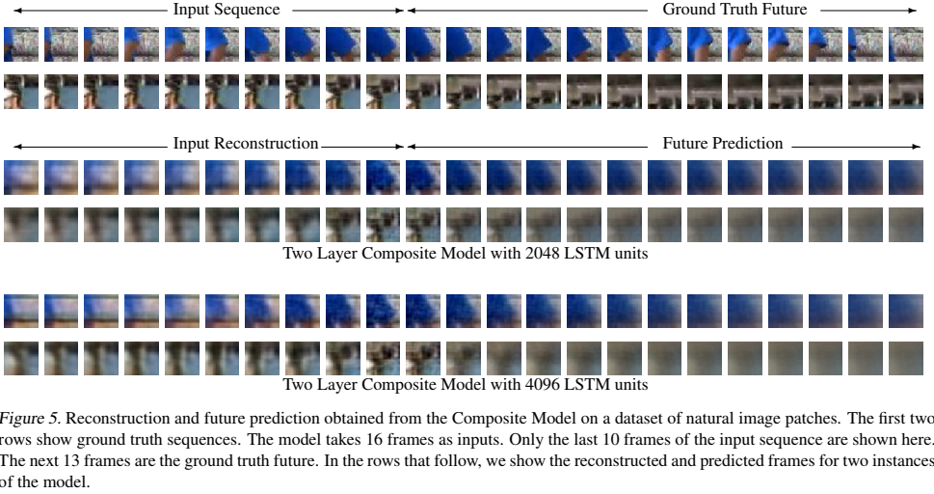
1
Composite models on natural image patches

Slide 8
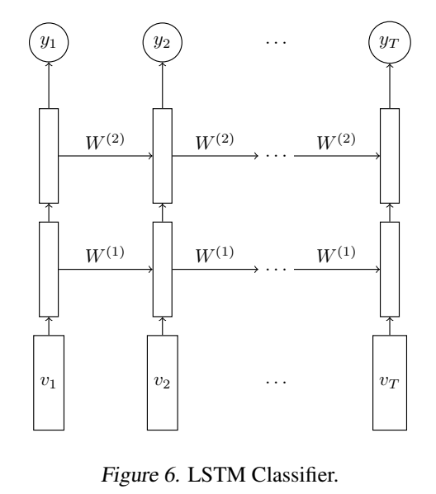
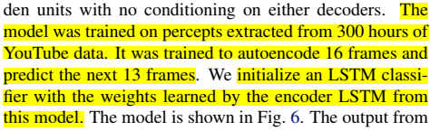
1
Action Recognition on UCF-101/HMDB-51
目标：观察 if the features
learned by unsupervised learning can help improve performance on supervised tasks

Slide 9
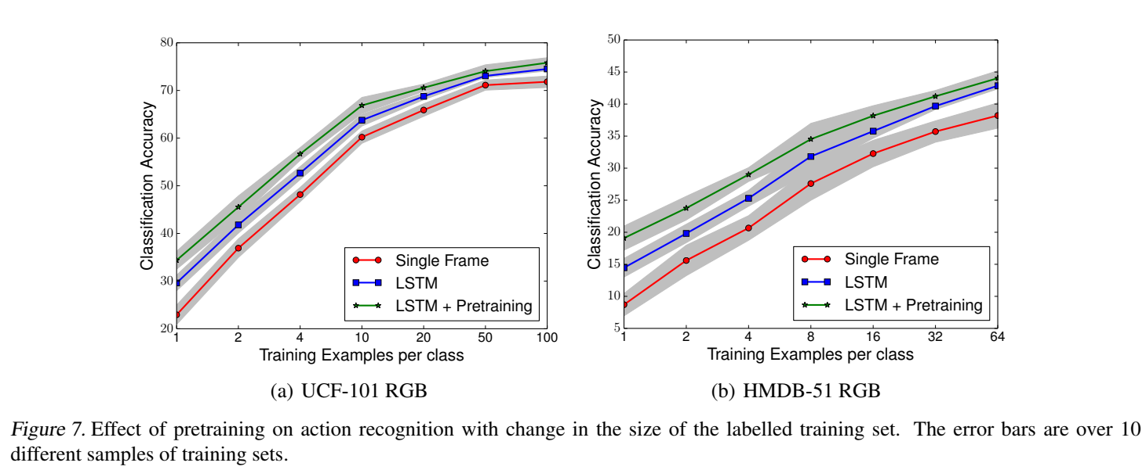
three models - single frame classifier, baseline LSTM classifier and the LSTM classifier initialized with weights from the Composite Model
1

Slide 10
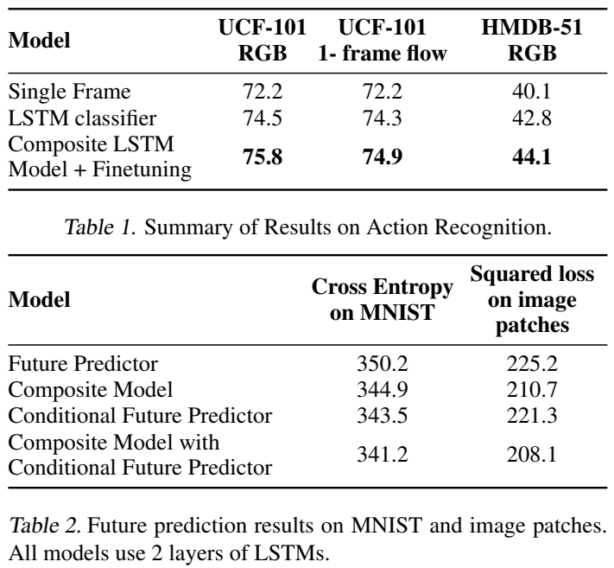
1
Future prediction results

Slide 11
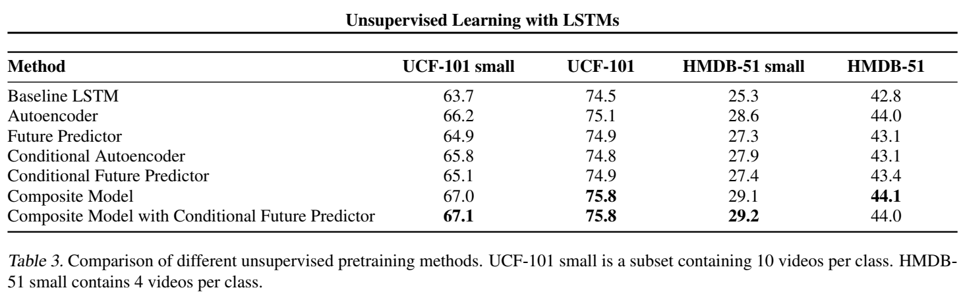
The performance on action recognition achieved by finetuning different unsupervised learning models
1

Slide 12
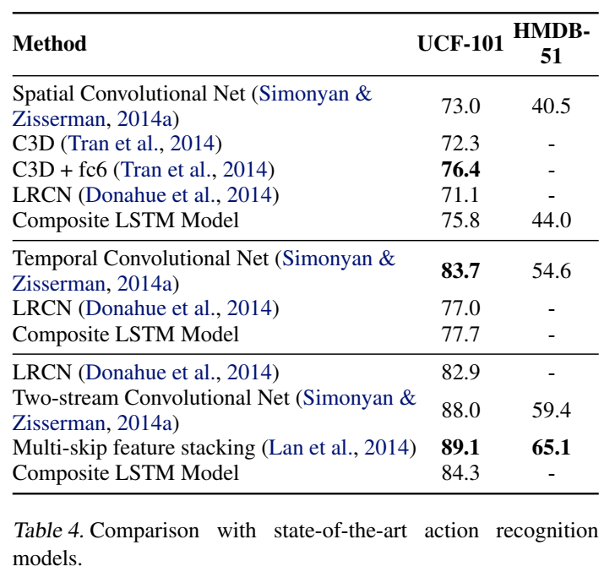
1
compare our models to the state-of-the-art action recognition results

Slide 13
4
Conclusion
LSTM Auto encoder可以实现的两类任务：
重建视频序列
预测未来的视频序列
两类研究难题：
Auto encoder的通病：越复杂越容易学到恒等映射，这是必须极力避免的。
Video representation要避免只存储short term的输入信息
未来研究：
在高层加入不会偏离数据流形的噪声，给预测输出带来随机性，如此，LSTM会表现的更好。

